Slide 1
Software Quality Management
Matakuliah Rekayasa Perangkat Lunak (CS215) – Gasal 2015/2016
Magister Ilmu Komputer - Universitas Budi Luhur
Achmad Solichin, S.Kom, M.T.I (achmatim@gmail.com)

Slide 2
Overview
Software Quality Management
SQM Activities
Software Quality attributes
ISO 9001 Quality Management Standards
Software Reviews and Inspections

Slide 3
Software Quality Management
Concerned with ensuring that the required level of quality is achieved in a software product.
Three principal concerns:
At the organizational level, quality management is concerned with establishing a framework of organizational processes and standards that will lead to high-quality software.
At the project level, quality management involves the application of specific quality processes and checking that these planned processes have been followed.
At the project level, quality management is also concerned with establishing a quality plan for a project. The quality plan should set out the quality goals for the project and define what processes and standards are to be used.

Slide 4
Quality Management Activities
Quality management provides an independent check on the software development process.
The quality management process checks the project deliverables to ensure that they are consistent with organizational standards and goals
The quality team should be independent from the development team so that they can take an objective view of the software. This allows them to report on software quality without being influenced by software development issues.

Slide 5
1. Specify how to manage
project documents
2. Identify process
1. QA Develops
and/or reviews
configuration
management
plans, standards ...
Quality Planning
2. QA reviews
process for
conformance to
organizational
policy
QM should have
some independence
from PM
QA
Quality Control
3. QA develops
and/or reviews
provision for
QA activities
5. QA reviews,
inspects & tests
4. QA reviews,
inspects & tests
5. Deliver & main-
tain the product
4. Design and build
3. Plan
Adapted from Software Engineering: An Object-Oriented Perspective by Eric J. Braude (Wiley 2001), with permission.

Slide 6
Quality management activities
Quality assurance
Establish organisational procedures and standards for quality
Quality planning
Select applicable procedures and standards for a particular project and modify these as required
Quality control
Ensure that procedures and standards are followed by the software development team
Quality management should be separate from project management to ensure independence

Slide 7
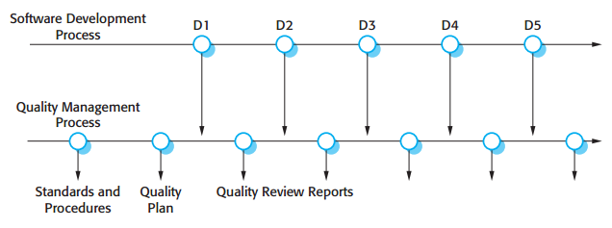
Quality Management and Software Development

Slide 8
Quality Planning
A quality plan sets out the desired product qualities and how these are assessed and defines the most significant quality attributes.
The quality plan should define the quality assessment process.
It should set out which organisational standards should be applied and, where necessary, define new standards to be used.

Slide 9
Quality Plan Structure ^{[Humphrey (1989)]}
Product introduction. A description of the product, its intended market, and the quality expectations for the product.
Product plans. The critical release dates and responsibilities for the product, along with plans for distribution and product servicing.
Process descriptions. The development and service processes and standards that should be used for product development and management.
Quality goals. The quality goals and plans for the product, including an identification and justification of critical product quality attributes.
Risks and risk management. The key risks that might affect product quality and the actions to be taken to address these risks.

Slide 10
What is Quality?
Quality, simplistically, means that a product should meet its specification
This is problematical for software systems:
Tension between customer quality requirements (efficiency, reliability, etc.) and developer quality requirements (maintainability, reusability, etc.)
Some quality requirements are difficult to specify in an unambiguous way
Software specifications are usually incomplete and often inconsistent

Slide 11
Software Fitness for Purpose
Have programming and documentation standards been followed in the development process?
Has the software been properly tested?
Is the software sufficiently dependable to be put into use?
Is the performance of the software acceptable for normal use?
Is the software usable?
Is the software well-structured and understandable?

Slide 12
Software Quality Attributes
Safety | Understandability | Portability
Security | Testability | Usability
Reliability | Adaptability | Reusability
Resilience | Modularity | Efficiency
Robustness | Complexity | Learnability

Slide 13
Quality attributes and software metrics

Slide 14
Process and Product Quality
The quality of a developed product is influenced by the quality of the production process.
This is important in software development as some product quality attributes are hard to assess.
However, there is a very complex and poorly understood relationship between software processes and product quality.
The application of individual skills and experience is particularly important in software development;
External factors such as the novelty of an application or the need for an accelerated development schedule may impair product quality.

Slide 15
A high quality products…
Satisfies clearly stated requirements
Checks its inputs and that it reacts in predictable ways to illegal inputs
Has been inspected thoroughly by others
Has been tested exhaustively by others
Is thoroughly documented
Has a known defect rate

Slide 16
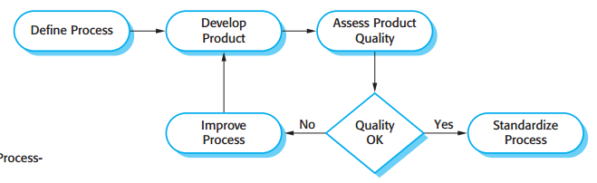
Process-based Quality

Slide 17
Software Standards
Standards define the required attributes of a product or process. They play an important role in quality management.
Standards may be international, national, organizational or project standards.
Product standards define characteristics that all software components should exhibit e.g. a common programming style.
Process standards define how the software process should be enacted.

Slide 18
Importance of Standards
Encapsulation of best practice- avoids repetition of past mistakes.
They are a framework for defining what quality means in a particular setting i.e. that organization’s view of quality.
They provide continuity - new staff can understand the organisation by understanding the standards that are used.

Slide 19
Product and Processes Standards
Product standards | Process standards
Design review form | Design review conduct
Requirements document structure | Submission of new code for system building
Method header format | Version release process
Java programming style | Project plan approval process
Project plan format | Change control process
Change request form | Test recording process

Slide 20
Problems with Standards
They may not be seen as relevant and up-to-date by software engineers.
They often involve too much bureaucratic form filling.
If they are unsupported by software tools, tedious form filling work is often involved to maintain the documentation associated with the standards.

Slide 21
ISO 9001 Standards Framework
An international set of standards that can be used as a basis for developing quality management systems.
ISO 9001, the most general of these standards, applies to organizations that design, develop and maintain products, including software.
The ISO 9001 standard is a framework for developing software standards.
It sets out general quality principles, describes quality processes in general and lays out the organizational standards and procedures that should be defined. These should be documented in an organizational quality manual.

Slide 22
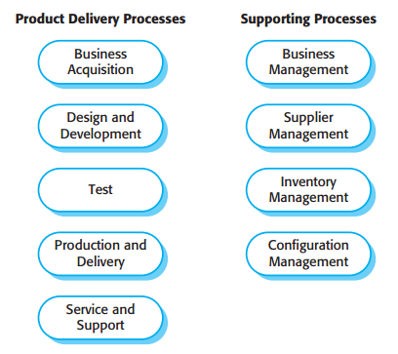
ISO 9001 Core Processes

Slide 23
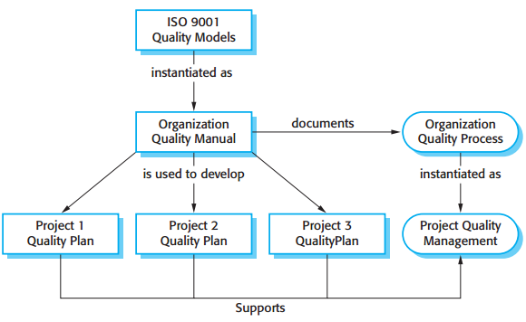
ISO 9001 and Quality Management

Slide 24
ISO 9001 Certification
Quality standards and procedures should be documented in an organisational quality manual.
An external body may certify that an organisation’s quality manual conforms to ISO 9000 standards.
Some customers require suppliers to be ISO 9000 certified although the need for flexibility here is increasingly recognised.

Slide 25
Reviews and Inspections
A group examines part or all of a process or system and its documentation to find potential problems.
Software or documents may be 'signed off' at a review which signifies that progress to the next development stage has been approved by management.
There are different types of review with different objectives
Inspections for defect removal (product);
Reviews for progress assessment (product and process);
Quality reviews (product and standards).

Slide 26
Quality Reviews
A group of people carefully examine part or all of a software system and its associated documentation.
Code, designs, specifications, test plans, standards, etc. can all be reviewed.
Software or documents may be 'signed off' at a review which signifies that progress to the next development stage has been approved by management.

Slide 27
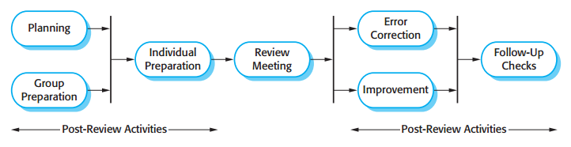
Software Reviews Process

Slide 28
Program inspections
These are peer reviews where engineers examine the source of a system with the aim of discovering anomalies and defects.
Inspections do not require execution of a system so may be used before implementation.
They may be applied to any representation of the system (requirements, design, configuration data, test data, etc.).
They have been shown to be an effective technique for discovering program errors.

Slide 29
Inspection checklists
Checklist of common errors should be used to drive the inspection.
Error checklists are programming language dependent and reflect the characteristic errors that are likely to arise in the language.
In general, the 'weaker' the type checking, the larger the checklist.
Examples: Initialisation, Constant naming, loop termination, array bounds, etc.

Slide 30
An inspection checklist (a)
Fault class | Inspection check
Data faults | Are all program variables initialized before their values are used? Have all constants been named? Should the upper bound of arrays be equal to the size of the array or Size -1? If character strings are used, is a delimiter explicitly assigned? Is there any possibility of buffer overflow?
Control faults | For each conditional statement, is the condition correct? Is each loop certain to terminate? Are compound statements correctly bracketed? In case statements, are all possible cases accounted for? If a break is required after each case in case statements, has it been included?
Input/output faults | Are all input variables used? Are all output variables assigned a value before they are output? Can unexpected inputs cause corruption?

Slide 31
An inspection checklist (b)
Fault class | Inspection check
Interface faults | Do all function and method calls have the correct number of parameters? Do formal and actual parameter types match? Are the parameters in the right order? If components access shared memory, do they have the same model of the shared memory structure?
Storage management faults | If a linked structure is modified, have all links been correctly reassigned? If dynamic storage is used, has space been allocated correctly? Is space explicitly deallocated after it is no longer required?
Exception management faults | Have all possible error conditions been taken into account?

Slide 32
Software Measurement and Metrics
See Previous Chapter

Slide 33
References
Roger S. Pressman, 2010, Software Engineering: A Practitioner’s Approach 7th edition, McGraw-Hill.
Ian Sommerville, 2011, Software Engineering 9th edition, Addison-Wesley.
Other references

Slide 34
Thanks
Achmad Solichin, S.Kom, M.T.I
achmatim@gmail.com
Twitter: @achmatim
Facebook: facebook.com/achmatim
Web: http://achmatim.net

